Slide 1
Year 11 Energy and Power Practise test
Convert;
a) 6kJ to J b) 15000J to kJ
c) 76 800J to kJ d) 4kWh to J
e) 6300kJ to kWh f) 15 Cal to J
g) 980 Cal to kWh h) 15000kJ to Cal
2. An air conditioner requires 3.2kW of power. Write the power requirements in watts.
3. A fridge uses 520kWh of energy in a year. Write this energy in kJ. Write this energy in:
a) kilojoules b) joules c) Calories
4. The Emu Downs wind farm in Western Australia can generate 79.2 MW of power. Write this in:
a) kilowatts b) watts
5. When Victoria swam for 30 minutes, she burned off 1300kJ of energy.
a) How many calories did she burn?
b) What was Victoria’s power output?
6. Find the energy used by:
a) a 300W computer in 4 hours
b) a 40 W light bulb in 8 Hours
c) a 2.5 kW clothes dryer in 30 minutes.

Slide 2
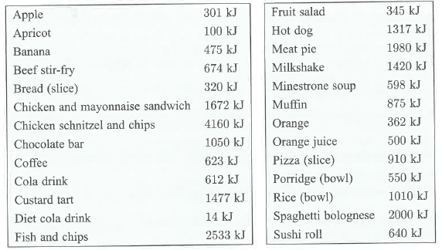
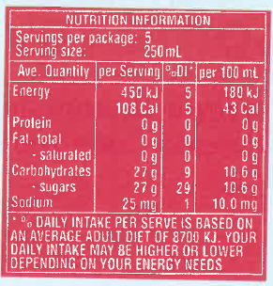
7. Gemma has a recommended daily energy intake of 8000kJ. For lunch she has 2 Sushi rolls, a custard tart, and an orange juice.
a) Use the table to calculate the energy in the meal.
b) What percentage of Gemma’s recommended daily intake is this?
c) Darren has a chicken Schnitzel with chips and a milkshake. Use the table to determine the number of Calories that are in the meal.
8. A bottle of soft drink has the nutritional information label shown alongside.
a) Convert 180kJ to calories. Does you’re answer agree with the value given on the bottle on the label?
b) Tony drank 300 mL from the bottle. Find the amount of energy he consumed in :
i) Kilojoules ii) calories

